Slide 1
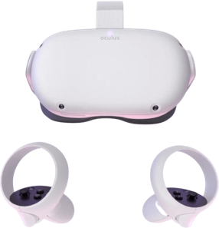
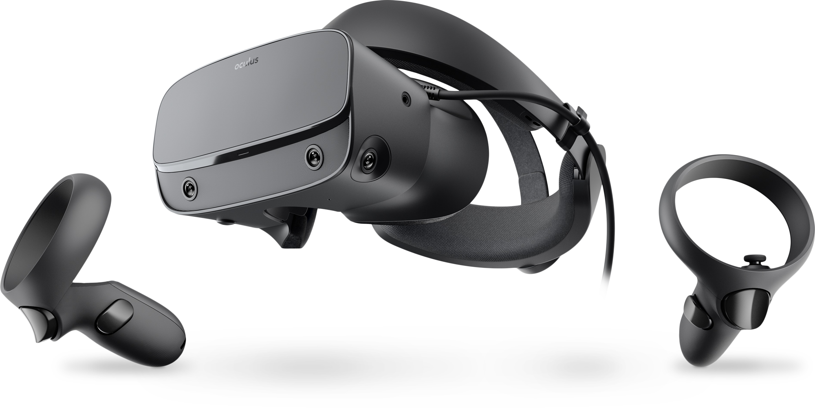


 | VIRTUAL REALITY | AUGMENTED REALITY | 360 DEGREE
Handle and manipulate things in the real world
Making visible the invisible
Manipulating space / time
Creating immersive experience without programming skills
Notes:
AR
Handle and directly manipulate things with the support of visual hints
AR/ VR
Seeing invisible things. For instance in the case of seeing the electricity / waters within pipes or in the case of VR seeing infinitely big things like – universe, solar system – or small – atoms, molecules
VR
Manipulating space and time means that user can play with this condition in his experience. It also means that the software can create space and time conditions difficult or impossible to access in the reality such as 1) dangerous situations (e.g. safety procedure), 2) situations in which it would be too expensive to use real materials 3) past situations (e.g. ancient Greece);
360 degree video
The unique advantage of 360 degree video is that it allows to create immersive experience without the need of programming skills and with relatively low costs.

Slide 2
Instructional advantages
AR: Akçayir & Akçayir, 2017; Bujak et al., 2013; Chen et al., 2017; Garzon et al., 2021; Jetter et al., 2018; Radu, 2014; Sirakaya & Sirakaya, 2020
VR: Allcoat et al., 2018; Hamilton et al., 2021; Huang et al., 2020; Jensen & Konradsen, 2017; Kaplan et al., 2021; Li et al., 2018; Wu et al., 2020
Motivation & engagement
Learning outcomes ? Depends...
Immersive > not immersive [VR]
Higher effect on procedural knowledge than theoretical knowledge [XR]
Simulation > than only representation or game-based approach [XR]
Notes:
In a recent meta-analyisis on VR it was found that VR is at least as effective as traditional methods, but further includes positive effects related to motivation, engagement, and raise of interest.​
​For VR, immersive technologies bring to higher learning outcomes (procedural and theoretical) than non immersive technologies (desktop).
​
XR had evidence for skill development and less for knowledge development. For procedural knowledge, it maintain the learning effect over time!
Simulation approaches produce better results than representation approaches or game-based approaches.​
​

Slide 3
Disadvantages
(e.g., Akçayir & Akçayir, 2017; Bacca et al., 2014; Bujak et al., 2013; Chen et al., 2017; Jetter et al., 2018; Lee et al., 2019; Moro et al., 2021; Park et al., 2019; Radu, 2014; Wuller et al., 2019)
Technical issues (e.g. perfect overlapping, response rate, graphical resolution,…)
Content development is difficult
Costs (HW, SW development,…)
Usability and Cybersickness

Slide 4
Summary
Facilitating conditions: infrastructures
(necessary but not sufficient conditions)
Design matters
  From interface to pedagogy;
  Teachers’ competence, i.e. knowledge, skills, attitudes
  Combine instead than substitute
  Give your learners a generative role (to avoid deskilling too)

